Slide 1
TIER-Plus: providing evidence to support HIV service prioritization decisions
Prioritization under pressure
Alexandra de Nooy, Amsterdam UMC
16 September 2026

Slide 2

2
WHAT IS TIER-PLUS?
A “what-if” tool for prioritization and programme decisions
INPUTS
country epidemiology and
intervention coverage
It can be used to consider: what if Malawi did more of this and less of that?
How many new HIV infections might be avoided?
What is the effect on the country’s 95 targets?
What would it cost?
Together these outputs could be used to answer whether these choices are good value for money.
SCENARIOS
change the
intervention mix
OUTPUTS
impact and cost over
one year
It compares choices side by side. It does not make the decision.
2
Notes:
Keep this plain — no jargon. “TIER-Plus is a what-if tool. You give it a country's current situation, you change the mix of interventions, and it estimates the consequences: infections avoided, cost, and who's reached. It lets you put options side by side. It does NOT make the decision for you.” Flag the one-year horizon now, honestly — we come back to why it matters on slide 10. [~1 min]

Slide 3
2
Back to our decisions
Not all prevention options can be prioritized at 100% coverage – how do we choose?
Oral PrEP
protect / expand the existing programme
Lenacapavir
introduce long-acting injectable PrEP
You told us what you'd want to know first:
infections averted
costs & value for money
numbers & populations reached
coverage & unmet need
acceptability & equity
VMMC
protect / expand circumcision
Condoms
protect condom programming
3
Notes:
Recap the choice the audience just voted on, then pivot to their Poll 2 answers. “You were asked to prioritise across these four — and you told us what you'd want to know before deciding. Let me show you how much of that a tool like TIER-Plus can actually put in front of you, using Malawi's real starting numbers.”

Slide 4
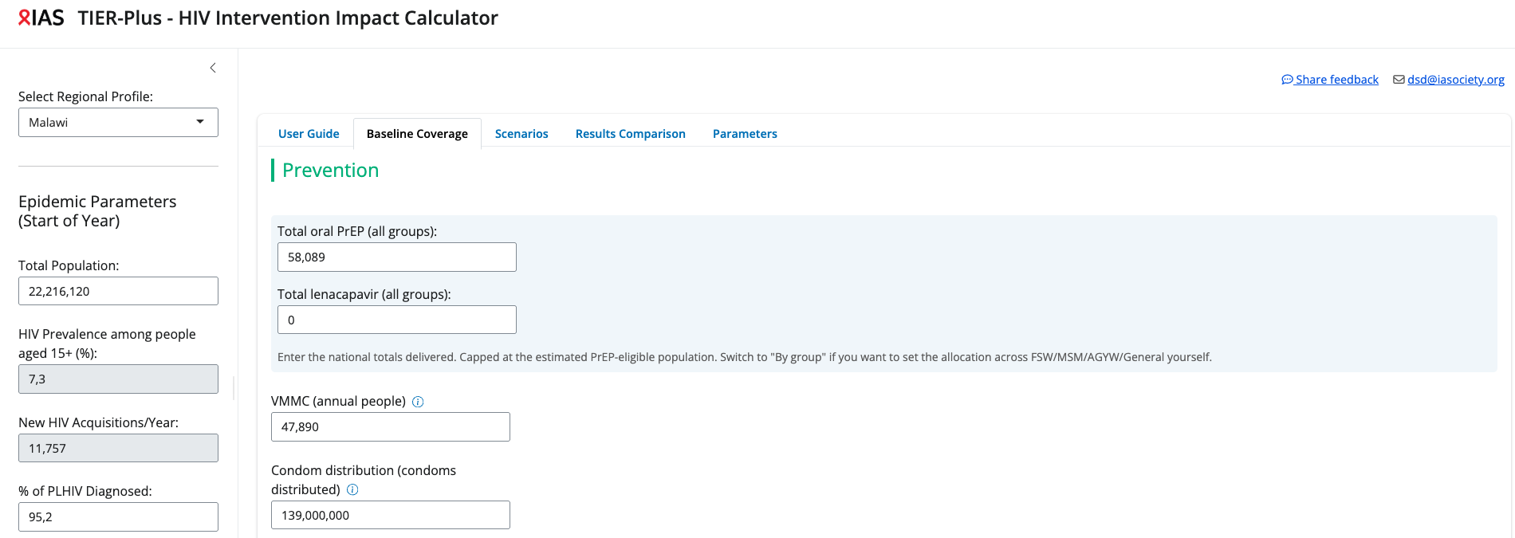
3
Prevention baseline
Malawi’s baseline prevention coverage
4
Notes:
Land the point that this is Malawi's REAL starting position, not a generic example. “This is where Malawi actually is — current coverage of each approach, and the gaps.

Slide 5
4
WHAT IF WE PRIORITISE DIFFERENTLY?
What if we changed our coverage of prevention services
1
2
Introduce Lenacapavir
Maintain overall number of people on PrEP by switching half of those on oral PrEP to Lenacapavir
Increase distribution of condoms
Increase the coverage of our less expensive interventions (per unit)
6
Notes:
Two scenarios – one in which we introduce new prevention tools like lenacapvir. Say by keeping the same total number of individual on Prep – but transition half from oral to lenacapvir. 2 priortitising our well known less costly interventions like condoms by increasing the numbers distributed

Slide 6
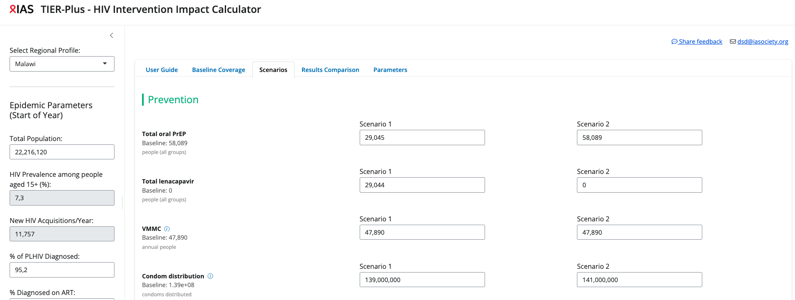
4
WHAT IF WE PRIORITISE DIFFERENTLY?
Building a scenario is just changing the numbers
5

Slide 7
5
WHAT IF WE PRIORITISE DIFFERENTLY?
The consequences, side by side
SCREENSHOT
TIER-Plus output comparison — three scenarios vs baseline:
infections averted · cost · value for money · populations reached
Point at one row at a time — don't read the whole table.
7
Notes:
This is the money slide. Walk it one line at a time: first infections averted across the three scenarios, then cost, then value for money, then reach. Let the numbers do the work — resist editorialising. Capture this screenshot from your actual Malawi run. [~1.5 min]

Slide 8
5
WHAT IF WE PRIORITISE DIFFERENTLY?
Reading the trade-offs
A
protects a working programme, but adds the least new impact
B
averts the most — [INSERT figure] — but costs the most per person reached
C
cheapest and widest reach, but averts fewer than B
There is no single “correct” answer — the tool shows the trade-offs, the room makes the call.
8
Notes:
Translate the table into plain trade-offs — and DO NOT crown a winner (the brief is explicit on this). Insert the real figures once you've run it. End on the reframe: the tool exposes the trade-offs; the decision still belongs to people. [~1 min]

Slide 9
6
WHAT TIER-PLUS CAN TELL YOU
“You told us what you wanted to know”
TIER-Plus can help with
It cannot — turn to slide 10
✓
infections averted
✗
community preferences & acceptability
✓
costs
✗
lived experience & access barriers
✓
value for money
✗
equity & human-rights considerations
✓
numbers & populations reached
✓
current coverage & unmet need
9
Notes:
Map straight back onto their Poll 2 options — this is the payoff of setting up the polls earlier. Tick what the tool answers, name what it doesn't, and use the crosses as the on-ramp to the next slide. Framing line: “You told us what you wanted to know — here's what we can help with, and here's what we honestly can't.” [~1 min]

Slide 10
6 · WHAT TIER-PLUS CANNOT TELL YOU
One input — not the decision
✗
One-year horizon — under-counts long-run benefit — especially VMMC, whose protection lasts a lifetime
✗
Not the whole picture — misses acceptability, lived experience and access barriers
✗
Not equity or rights — can't weigh who is left behind, or human-rights considerations
✗
Not why people choose — can't tell you why someone prefers one option over another
10
Notes:
The trust slide — slow down here. This audience will (rightly) be wary of a model being used to justify cuts, so be disarmingly honest. Say the one-year horizon point out loud: a single year captures almost none of VMMC's lifetime protection, so short-horizon modelling structurally understates durable prevention — flag the direction of the bias, and note it cuts against lenacapavir too. Then the human limits: acceptability, access, equity, rights, and the reasons people actually choose. “This is one input. It doesn't make the decision, and it can't see everything that matters.” [~1.5 min]

Slide 11
7
HOW COMMUNITIES CAN USE IT
A tool to interrogate — not to defer to
1
Ask sharper questions about proposed investments
2
Challenge the assumptions behind a plan
3
Compare alternatives on the same terms
4
Advocate for a scenario that isn't on the table
5
Help decide which scenarios get modelled at all
11
Notes:
Speak directly to the room — second person throughout. The through-line: this shifts a little power toward the people in the decision. The strongest point is the last one — communities shaping WHICH scenarios get modelled in the first place, not just reacting to options handed down. [~1 min]

Slide 12
THE KEY MESSAGE
TIER-Plus doesn't tell Malawi what to prioritise. It makes the consequences of each choice visible — so decisions are transparent, evidence-based, and open to challenge.
The numbers are only part of the picture — over to Clarence for the evidence modelling alone can't provide.
12
Notes:
Deliver the key message verbatim — it's the one line you want them to remember. Then hand cleanly to Clarence, whose talk is about exactly the things this slide says the model can't see. Don't add a 'thank you / questions' slide — the handover IS the close. [~30s]

